Slide 1
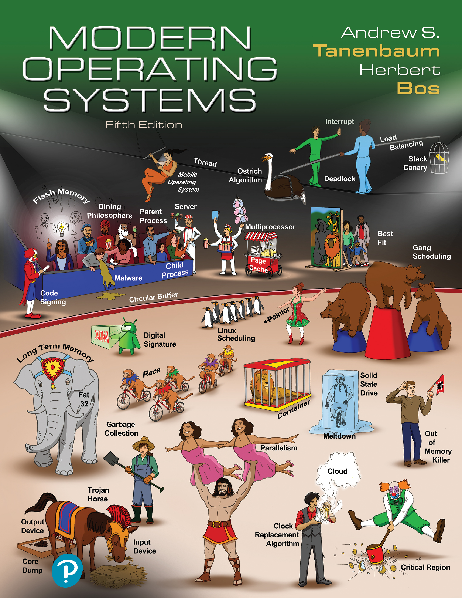

Modern Operating Systems
Fifth Edition
Chapter 7
Virtualization and the Cloud
Copyright © 2023, 2014, 2008 Pearson Education, Inc. All Rights Reserved
Notes:
If this PowerPoint presentation contains mathematical equations, you may need to check that your computer has the following installed:
1) Math Type Plugin
2) Math Player (free versions available)
3) NVDA Reader (free versions available)

Slide 2
Problem (1)
Enterprise I T centers support many service applications
Microsoft Exchange
Oracle
S A P
Each service application demands its own environment
Specific version of operating system
Multiple processors and disks
Specialized configurations

Slide 3
Problem (2)
Combining services on same server host is difficult (at best)
Conflicting demands
Incompatible loads
Upgrading or commissioning a service is very difficult
Shadow server machines for debugging & testing
Complicated changeover tactics

Slide 4
Problem (3)
Adding or upgrading hardware or O S is difficult
Testing and refitting active service
Complicated changeover tactics
Load balancing is impossible
Services tied to own systems
Some underused, some overused

Slide 5
Solution: Virtualization
Decouple [O S, service] pair from hardware
Multiplex lightly-used services on common host hardware
Migrate services from host to host as needed
Introduce new [O S, service] pairs as needed
Commissioning new services
Testing upgrades of existing services
Experimental usage

Slide 6
Virtual Machine (1 of 2)
Virtual machine provides interface identical to underlying bare hardware
I.e., all devices, interrupts, memory, page tables, etc.
Operating systems can be blissfully unaware
Not the only model
Paravirtualization uses the cooperation of the O S
Notes:
Long Description:

Slide 7
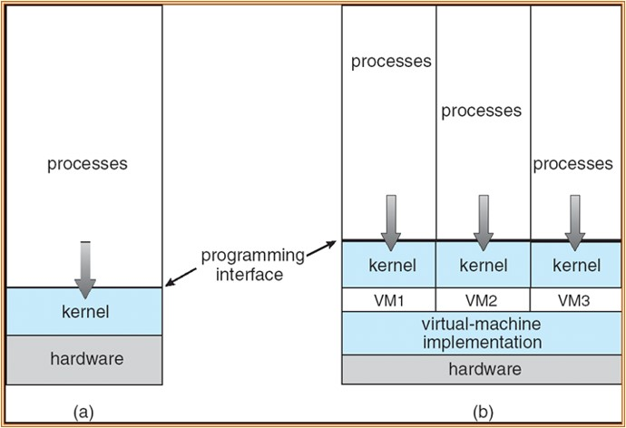
Virtual Machine (2 of 2)
Avi Silberschatz, Peter Baer Galvin, Greg GagneOperating System Concepts, Ninth Edition, Silberschatz, Galvin and Gagne, 2013
Notes:
Long Description:
In A, a vertical box is divided into 3 sections namely processes, kernel, and hardware. In B, the box is divided into 3 vertical boxes with further 3 sections namely processes, kernel, and V M 1, V M 2, and V M 3, respectively. virtual machine implementation and hardware are marked below. Four downwards arrows are between processes and kernels in each section. The line between processes and kernel is marked as a programming interface.

Slide 8
Hypervisor or Virtual Machine Monitor (V M M)
Creates illusion of multiple machines on the same hardware
Type 1 versus Type 2 (Goldberg 1972):
Type 1 hypervisor: runs on bare metal
Type 2 hypervisor: makes use of abstractions and services offered by underlying O S

Slide 9
Requirements for Virtualization
Hypervisors should score well in three dimensions:
Safety: The hypervisor should have full control of virtualized resources.
Fidelity: The behavior of a program on a virtual machine should be identical to same program running on bare hardware.
Efficiency: Much of code in virtual machine should run without intervention by hypervisor.

Slide 10
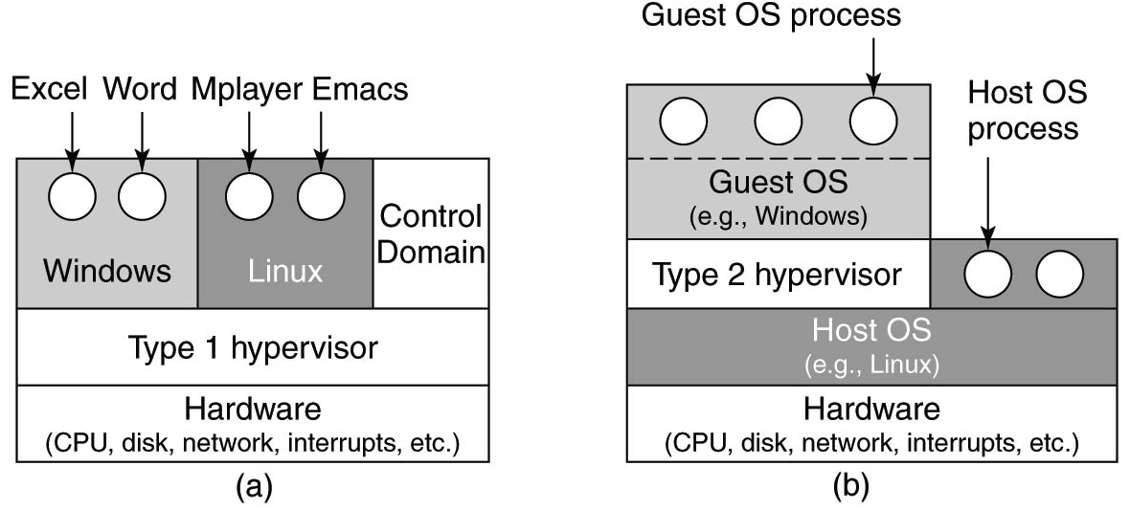
Type 1 and Type 2 Hypervisors (1)
Figure 7.1 Location of type 1 and type 2 hypervisors.
Notes:
Long Description:
The figure contains two parts. Part 1: A block divided consisting of four segments is shown. The first segment is divided into three parts labeled windows, Linux, and control domain. The windows part has two sets of open circles labeled Excel, word. The Linux part also has two sets of open circles labeled M player and Emacs. The second segment is labeled Type 1 hypervisor and the third segment is labeled Hardware (C P U, disk, network, interrupts, etcetera).
Part 2: It also contains a block containing three segments labeled from the bottom as follows. Hardware (C P U, disk, network, interrupts, etcetera), Host O S (example: Linux), Type 2 hypervisor. The Type 2 hypervisor has two sets of open circles labeled host O S process. A block labeled Guest O S (example: windows) which has half the length of a type 2 hypervisor is placed above it. The Guest O S block also has two sets of open circles labeled Guest O S process.

Slide 11
Type 1 and Type 2 Hypervisors (2)
Virtualization method | Type 1 hypervisor | Type 2 hypervisor
Virtualization without H W support | E S X Server 1.0 | VMware Workstation 1
Paravirtualization | Xen 1.0 | VirtualBox 5.0+
Virtualization with H W support | vSphere, Xen, Hyper-V | VMware Fusion, K V M, Parallels
Process virtualization | Blank | Wine
Figure 7.2 Examples of hypervisors. Type 1 hypervisors run on the bare metal whereas type 2 hypervisors use the services of an existing host operating system.

Slide 12
Quiz (1 of 2)
Where are the drivers (e.g., for the network card, disk, etc)?
Notes:
Long Description:
The figure contains two parts. Part 1: A block divided consisting of four segments is shown. The first segment is divided into three parts labeled windows, Linux, and control domain. The windows part has two sets of open circles labeled Excel, word. The Linux part also has two sets of open circles labeled M player and Emacs. The second segment is labeled Type 1 hypervisor and the third segment is labeled Hardware (C P U, disk, network, interrupts, etcetera).
Part 2: It also contains a block containing three segments labeled from the bottom as follows. Hardware (C P U, disk, network, interrupts, etcetera), Host O S (example: Linux), Type 2 hypervisor. The Type 2 hypervisor has two sets of open circles labeled host O S process. A block labeled Guest O S (example: windows) which has half the length of a type 2 hypervisor is placed above it. The Guest O S block also has two sets of open circles labeled Guest O S process.

Slide 13
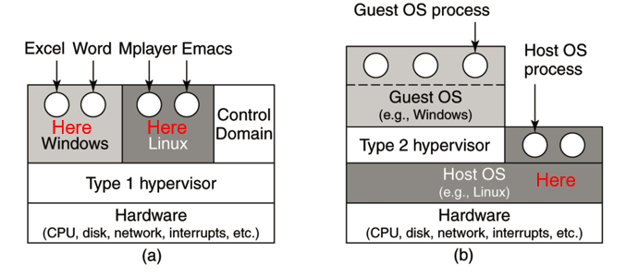
Quiz (2 of 2)
Where are the drivers (e.g., for the network card, disk, etc)?
Notes:
Long Description:
Diagram (a) shows the block with three rows. Row 1 on top has three sections. First shows Excel and word windows. The word here is indicated in this section. The second section shows mplayer and emacs Linux. The word here is indicated in this section. The third section is labeled as the control domain. The second row is labeled as a type 1 hypervisor. Row 3 is labeled as hardware (C P U, disk, network, interrupts, etcetera). Diagram (b) shows the block with four rows. The top row is small and shows three circles labeled as guest O S process; Guest O S (example windows). Row 2 shows 2 sections. The first section is labeled as type 2 supervisor and section 2 is labeled as host O S process. Section 3 is labeled as host O S (for example Linux). The word here is indicated in this section. Row 4 is labeled as hardware (C P U, disk, network, interrupts, etcetera).

Slide 14
History: [1960s - 1970s] I B M C P-67/C M S (1)
I B M Cambridge Scientific Center
Ran on I B M 360/67
Replicated hardware in each “process”
Virtual 360/67 processor
Virtual disk(s), virtual console, printer, card reader, etc.
C M S: Cambridge Monitor System
A single user, interactive operating system
Commercialized as V M 3 7 0 in mid-1970s

Slide 15
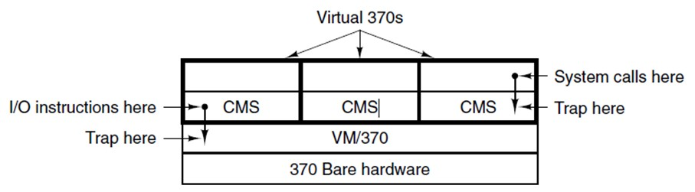
History: [1960s - 1970s] I B M C P-67/C M S (2)
for I B M System 360, 370, etc.
The structure of V M/370 with C M S.
Notes:
Long Description:
It comprises a box divided into 2 sections. On the top, it has 3 columns and 2 rows and is labeled virtual 370 s. The second row is marked as C M S. On the top right, an arrow points downwards with system call here and trap here marked at the ends. On the bottom, it has 2 horizontal sections labeled V M over 370 and 370 bare hardware. On the left, an arrow points downwards from the top section to the bottom section with A over A instructions here and trap here on each end.

Slide 16
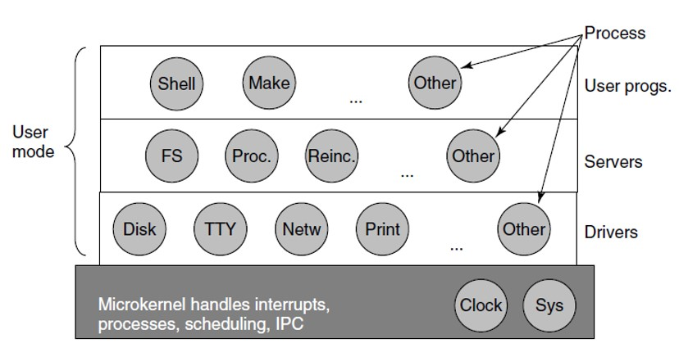
Compare with Microkernels (E.G., M I N I X)
Notes:
Long Description:
It comprises a box divided into 4 horizontal boxes with 3, 4, 5, and 2 circles, respectively. The first 3 rows are marked as user mode. On the right, the first 3 rows are marked labeled as user progs dot, servers, and drivers. A process on the top right has 3 arrows that point at the circles on each row labeled the other. The last row labeled as microkernels handles interrupts processes, scheduling, I P C.

Slide 17
History: [1974] Popek and Goldberg Publish a Paper
“Formal requirements for Virtualizable Third Generation Computers”
It listed what conditions a computer architecture must satisfy to support virtualization
Interestingly, the x 8 6 (also from the 70s!) did not meet these requirements
Very briefly, to be virtualizable, when a privileged instruction is executed in user mode, it needs to trap, not just be ignored

Slide 18
History: [1990s] The D I S C O Revolution
Ed Bugnion et al. at Stanford develop a new hypervisor (“Disco”)
Virtualization went ballistic, enabling the 2000s cloud revolution
(Even though the theory had been nailed down in 1974)
The D I S C O people went on to found V M ware

Slide 19
The Challenges of Virtualization on the x86 (1)
Core attributes of a virtual machine to x86-based target platform:
Compatibility
Performance
Isolation

Slide 20
The Challenges of Virtualization on the x86 (2)
Major Challenges:
The x 8 6 architecture was not virtualizable
The x 8 6 architecture was of daunting complexity
x 8 6 machines had diverse peripherals
Need for a simple user experience

Slide 21
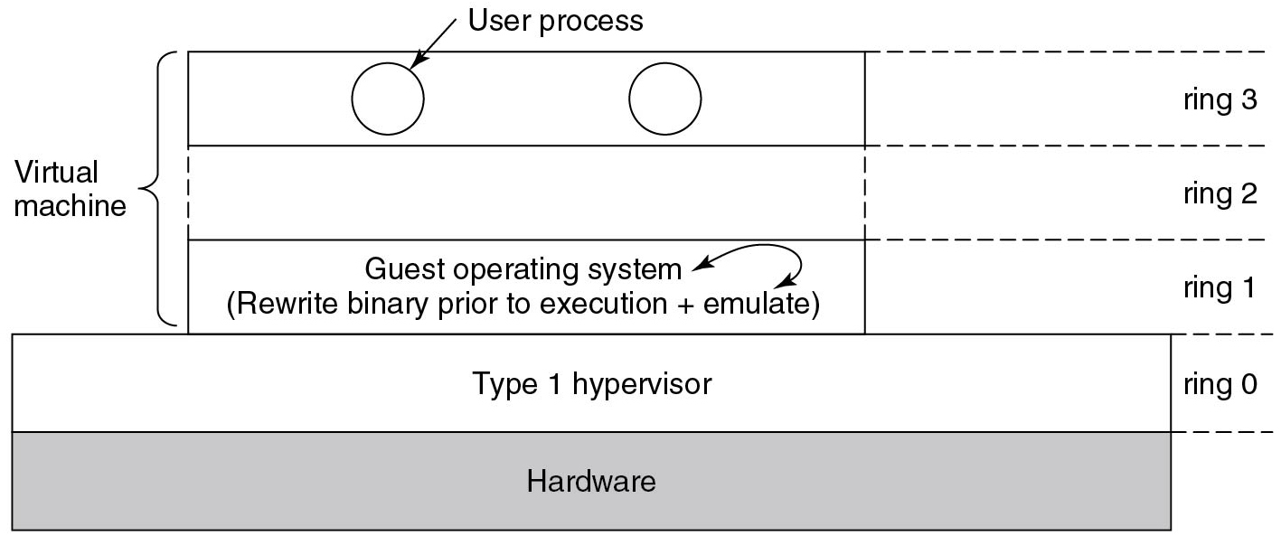
Binary Translation: Virtualizing the Unvirtualizable
Figure 7.4 The binary translator rewrites the guest operating system running in ring 1, while the hypervisor runs in ring 0.
Notes:
Long Description:
The figure shows a block containing two segments labeled from the bottom as Hardware and Type 1 hypervisor. A smaller block labeled virtual machine is placed above the previous block. It consists of three segments labeled ring 1, ring 2, and ring 3. The Type 1 hypervisor segment is labeled ring 0. Ring 1 contains a guest operating system (rewrite binary before execution plus emulate). The ring 3 consists of two open circles labeled user process.

Slide 22
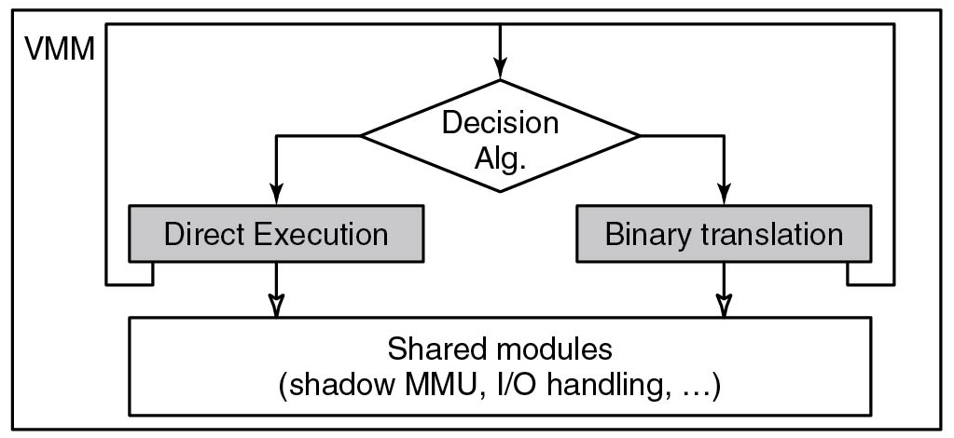
V M W are: Virtualizing the x 8 6 Architecture (1)
Figure 7.8 High-level components of the V Mware virtual machine monitor (in the absence of hardware support).
Notes:
Long Description:
The flow chart starts with a block labeled Decision A l g. Two arrow points from this block to two other blocks labeled direct execution and binary translation. The decision A l g is also connected to these two blocks using a line labeled V M M. Two arrows from the direct execution and binary translation blocks point to a block labeled shared modules (shadow M M U, I O handling etcetera).

Slide 23
V M Ware: Virtualizing the x 8 6 Architecture (2)
Binary translation must be used if any of the following is true:
Virtual machine is currently running in kernel mode
Virtual machine can disable interrupts and issue I/O instructaion
Virtual machine is currently running in real mode

Slide 24
V M W are: Virtual Hardware Platform (1)
Virtual Hardware (front end) | Back end
1 virtual x86 C P U, with the same instruction set extensions as the underlying hardware C P U | Scheduled by the host operating system on either a uniprocessor or multiprocessor host
Up to 512 M B of contiguous D R A M | Allocated and managed by the host O S (page-by-page)
Figure 7.9 Virtual hardware configuration options of the early V M ware Workstation, ca. 2000.

Slide 25
V M W are: Virtual Hardware Platform (2)
Virtual Hardware (front end) | Back end
P C I Bus | Fully emulated compliant P C I bus
Four Units of ID E disks Seven units of Buslogic S C S I Disks | Virtual disks (stored as files) or direct access to a given raw device
One unit of I D E C D-R O M | I S O image or emulated access to the real C D-R O M
Two units of 1.44 M B floppy drives | Physical floppy or floppy image
One unit of V M ware graphics card with V G A and S V G A support | Ran in a window and in full-screen mode. S V G A required VMware S V G A guest driver
Two times of serial ports C O M 1 and C O M2 | Connect to host serial port or a file
One unit of printer (L P T) | Can connect to host L P T port
One unit of keyboard (104-key) | Fully emulated; keycode events are generated when they are received by the VMware application
One unit of P S-2 mouse | Same as keyboard
Three units of A M D Lance Ethernet cards | Bridge mode and host-only modes
One unit of Soundblaster | Fully emulated
Figure 7.9 Virtual hardware configuration options of the early V M ware Workstation, ca. 2000.

Slide 26
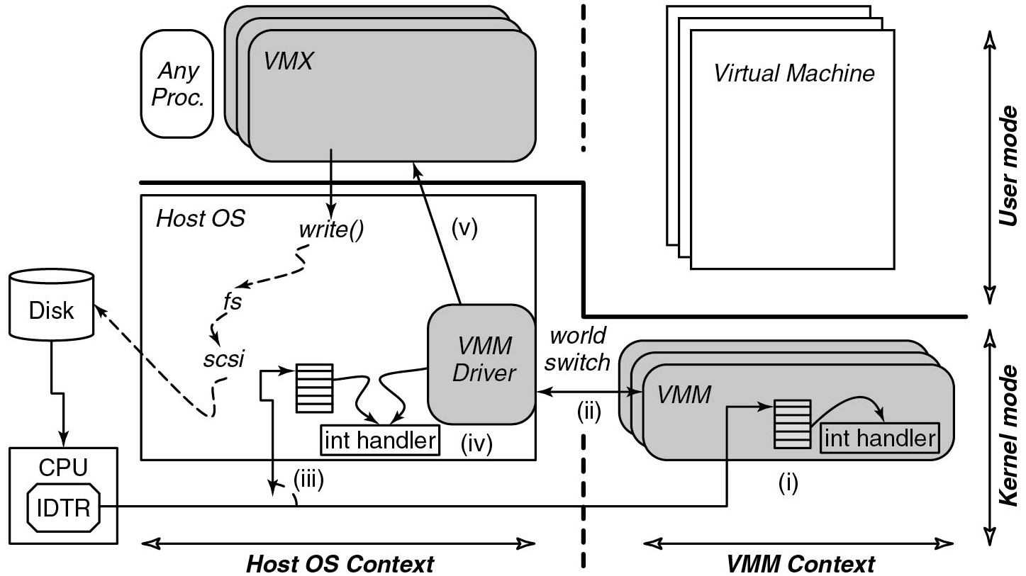
V M Ware: Role of the Host Operating System (1)
Figure 7.10 The V M ware Hosted Architecture and its three components: V M X, V M M driver, and V M M.
Notes:
Long Description:
The first section of architecture labeled user mode contains a set of three layers of blocks labeled V M M placed at the upper left end. A block labeled any proc is placed left of it. Another layer of blocks labeled virtual machine is placed at the upper right end. The V M X and Virtual machines blocks are separated by a dashed line. The next section labeled kernel-mode consists of a block labeled host O S. An arrow from the V M X points to a function write function in this block. It is pointed to a disk through f s and s c s i. A small block is placed inside the host O S labeled V M M driver which points toward the V M X. An arrow from the V M M driver and a vertical block points to an int handler. An arrow from the disk points to a block labeled C P U which also contains I D T R. This part is labeled Host O S context. Another arrow from the I D T R points to a layer of blocks labeled V M M which also contains a vertical block and an int handler. This part is labeled V M M context. A double-headed arrow points to the vertical block in the host O S context and V M M context.

Slide 27
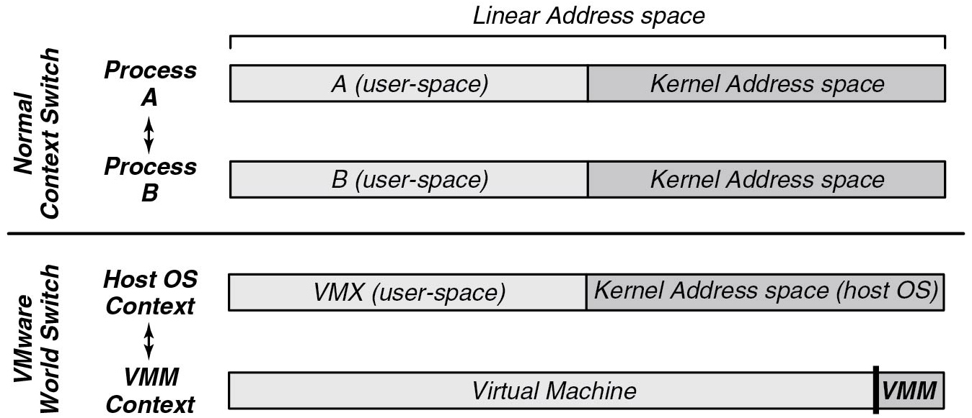
V M Ware: Role of the Host Operating System (2)
Figure 7.11 Difference between a normal context switch and a world switch.
Notes:
Long Description:
The figure shows two sets of blocks labeled normal context switch and V M ware world switch. The normal context switch contains two blocks process A and Process B. The block under process A is divided into two parts labeled A (user space) and Kernel space. The block as a whole is labeled linear address space. The block under process B is divided into two parts labeled B (user space) and Kernel space.
The V M ware world switch contains two blocks host O S context and V M M context. The block under the host O S context is divided into two parts labeled V M X (user space) and kernel address space (host O S). The block under the V M M context is divided into two parts labeled virtual machine and V M M. Here the virtual machine occupies a larger part and V M M occupies a smaller part.

Slide 28
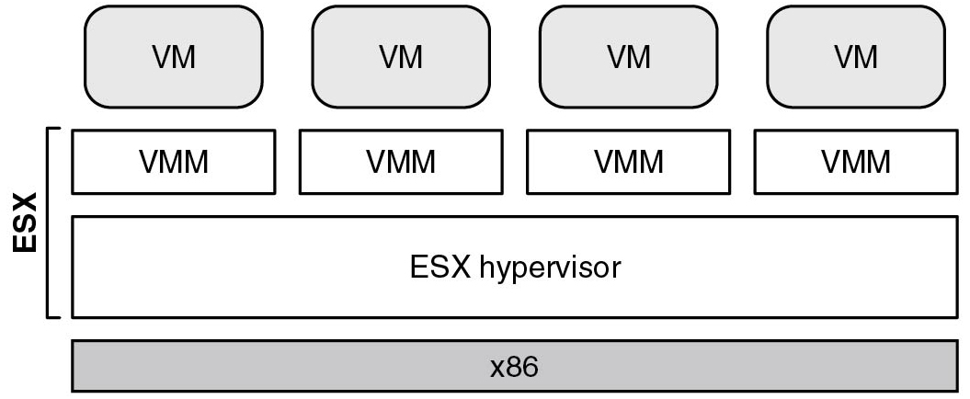
E S X Server: V Mware’s type-1 Hypervisor (1)
Figure 7.12 E S X Server: V M ware’s type-1 hypervisor
Notes:
Long Description:
The figure contains four blocks labeled V M placed side by side. Another set of four blocks labeled V M M are placed below the previous blocks. Below the V M M blocks, a block labeled ES X hypervisor is placed and a block labeled x 86 is placed below it. The V M M blocks and E S X hypervisor block together are labeled E S X.

Slide 29
E S X Server: V Mware’s type-1 Hypervisor (2)
E S X Server architecture provides substantial benefits
C P U scheduler ensures that each virtual machine gets a fair share of the C P U
Memory manager is optimized for scalability
I/O subsystem is optimized for performance
Back ends also typically relied on abstractions provided by host operating system.
E S X Server made it easy to introduce new capabilities

Slide 30
Hardware-supported Virtualization Technology
In 2005, Intel introduced Virtualization Technology (V T-x)
A M D followed with A M D-v
I/O instructions, etc, trap to the hypervisor which does the work on behalf of the virtual machine
Notes:
Long Description:
Part (a): It is labeled as a three-stage pipeline. There are three blocks connected with each other with a forward arrow. The first block is labeled Fetch unit, the second block is labeled Decode unit and the third block is labeled Execute unit. Part (b): It is labeled as Superscalar CPU. There are seven square-shaped blocks and an ellipse-shaped block at the center of the square-shaped blocks. The first two top blocks are labeled as Fetch unit and Decode unit. Similarly, the bottom two blocks are labeled as Fetch unit and Decode unit. In the center, the ellipse-shaped block is labeled Holding buffer. Both Fetch units are connected to both Decode units with arrows and similarly, both decode units are connected with Holding buffer with the forward arrows. The Holding buffer is connected with the other three blocks labeled Execute unit placed on the right of the Holding buffer block.

Slide 31
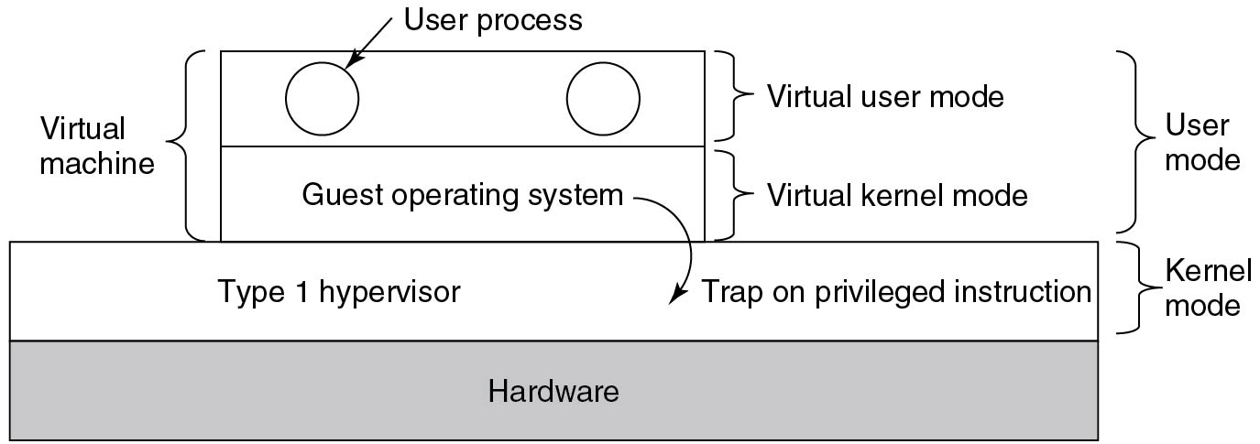
Techniques for Efficient Virtualization
Figure 7.3 When the operating system in a virtual machine executes a kernel only instruction, it traps to the hypervisor if virtualization technology is present.
Notes:
Long Description:
The figure consists of a block containing two segments labeled from the bottom as Hardware and Type 1 hypervisor. The Type 1 hypervisor is labeled kernel mode. A smaller block labeled virtual machine is placed above the previous block. It consists of two segments labeled virtual kernel mode and virtual user mode. They have together labeled user mode. The virtual kernel mode contains a guest operating system that is pointed toward the type 1 hypervisor segment using an arrow labeled trap on privileged instruction. The virtual user mode consists of two open circles labeled user process.

Slide 32
Memory Virtualization (1 of 2)
There is a problem though
Suppose guest O S A wants to map virtual page 5 on physical page 3
Later, guest O S B wants to map its virtual page 7 also on physical page 3
What do we do?
Hypervisor creates a shadow page table that maps V M s’ virtual pages to actual pages the hypervisor hands out
Needs shadow page tables (P T s) for every V M

Slide 33
What to do When Guest O S Changes Page Tables?
Just a write operation for the guest
but requires update in shadow page tables
Possible solution: make P T s read-only
trap on update
Also must trap on I N V L P G (invalidate page) instruction which removes a mapping
Clearly, doing so is expensive due to the many page faults (especially costly in virtualized environment due to V M Exits)
More efficient solutions introduced later

Slide 34
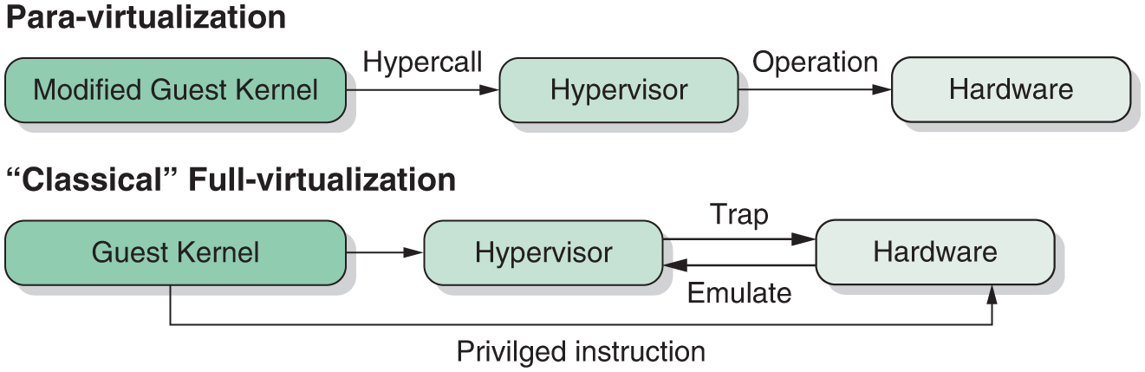
Paravirtualization
Do not pretend to be hardware, make O S aware that it is in a V M
This makes many things easier
For instance, after updating a P T: simply tell the hypervisor
Notes:
Long Description:
For paravirtualization, the steps are as follows. Modified guest kernel to hypervisor via hypercall, hypervisor to hardware via operation. For classical full virtualization, the steps are as follows. guest kernel to hardware via privileged instruction, hypervisor to hardware, and vice versa via emulate and trap, respectively.

Slide 35
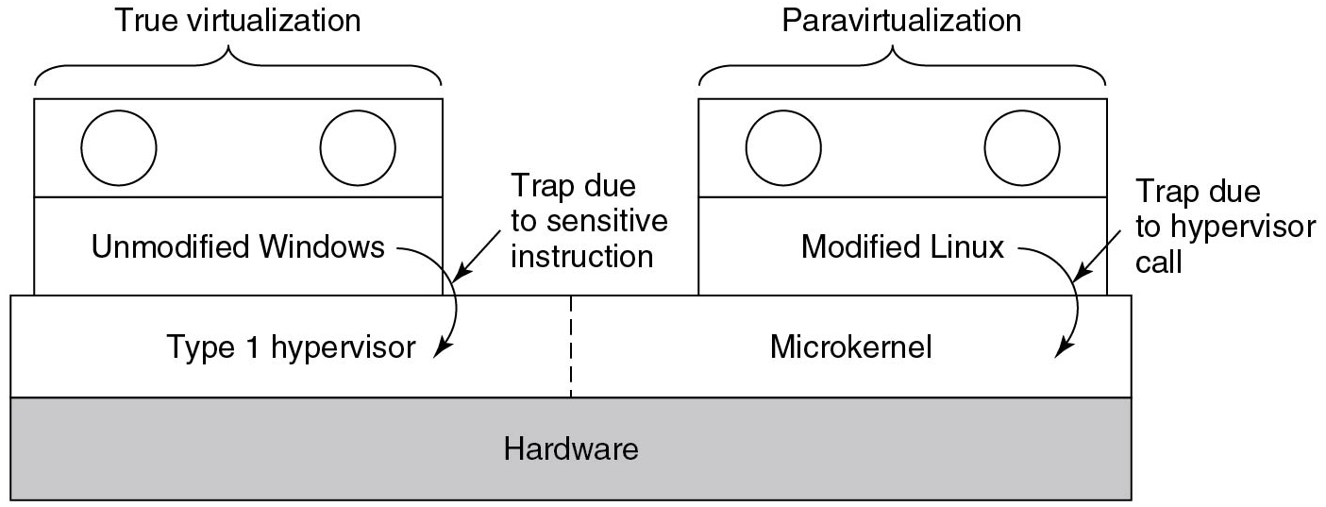
Are Hypervisors Microkernels Done Right? (1)
Figure 7.5 True virtualization and paravirtualization.
Notes:
Long Description:
The figure shows a block containing two segments. The bottom segment is labeled hardware. The top segment is divided into two parts labeled type 1 hypervisor and microkernel using a dashed line. Two smaller blocks are placed on the two sides of the top segment. The left block contains two segments, the first segment is labeled unmodified windows which point toward type 1 hypervisor using an arrow labeled trap due to sensitive instruction and the second segment consists of two open circles labeled true virtualization. The right block also contains two segments. The first segment is labeled modified Linux which points toward the microkernel using an arrow labeled trap due to hypervisor call and the second segment consists of two open circles labeled paravirtualization.

Slide 36
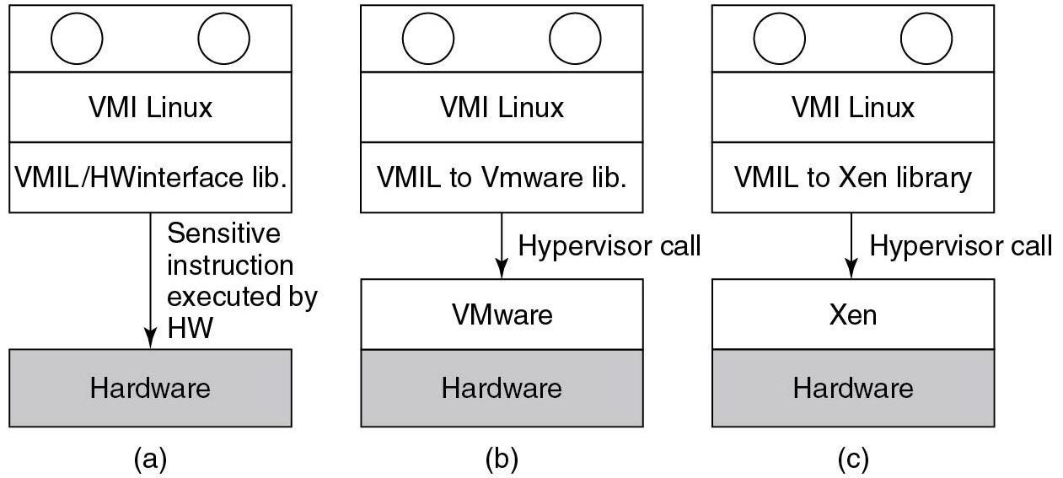
Are Hypervisors Microkernels Done Right? (2)
Figure 7.6 V M I Linux running on (a) the bare hardware (b) Vmware, and (c) Xen.
Notes:
Long Description:
Figure a: It contains two blocks connected by an arrow pointed downward labeled Sensitive instruction executed by H W. The bottom block is labeled hardware. The top block consists of three segments. The first segment contains two open circles, the second segment is labeled V M I Linux, and the third segment is labeled V M I L or H W interface library.
Figure b: It contains two blocks connected by an arrow pointed downward labeled Hypervisor call. The bottom block consists of two segments labeled VMware and hardware. The top block consists of three segments. The first segment contains two open circles, the second segment is labeled V M I Linux, and the third segment is labeled V M I L to Vmware library.
Figure c: It contains two blocks connected by an arrow pointed downward labeled Hypervisor call. The bottom block consists of two segments labeled Xen and hardware. The top block consists of three segments. The first segment contains two open circles, the second segment is labeled V M I Linux, and the third segment is labeled V M I L to Xen library.

Slide 37
Later: H W Support For Nested Page Tables Arrived
Intel terminology: Extended Page Tables (E P T)
Hypervisor still maintains additional set of page tables, but C P U walks them
Guest V A
Guest P A
Machine Address (or “real
physical address”)
Note: these page tables may be accessed more often than you think

Slide 38
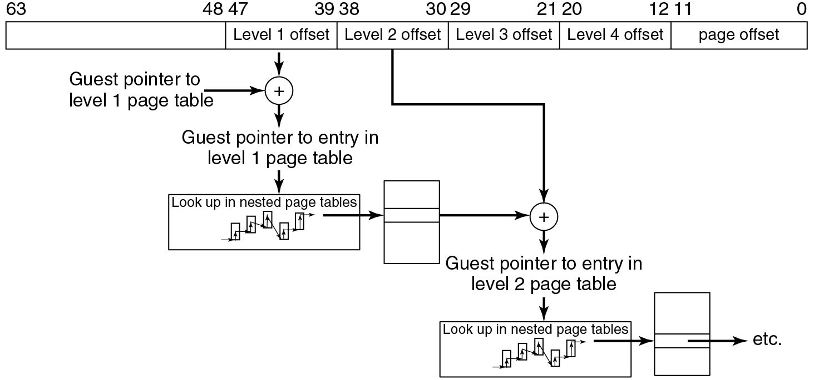
Hardware Support for Nested Page Tables
Figure 7.7 Extended/nested page tables are walked every time a guest physical address is accessed—including the accesses for each level of the guest’s page tables.
Notes:
Long Description:
The figure shows a rectangular block containing six columns labeled from left to right as follows. Blank, Level 1 offset, Level 2 offset, Level 3 offset, Level 4 offset, and page offset. The boundary of each column is numbered as 63, 48 47, 39 38, 30 29, 21 20, 12 11, 0. The level 1 offset column is pointed to the first adder labeled Guest pointer to the level 1 page table. The adder points to a block using an arrow labeled Guest pointer to the entry in the level 1 page table. The block represents Lookup in nested page tables. An arrow from this block points to a vertical block which again points to the second adder. An arrow from the level 2 offset also points to this adder. The adder points to another block representing Lookup in the nested page table. An arrow points from this to a vertical block and then again an arrow from this vertical block points outward and continues.

Slide 39
Memory Virtualization (2 of 2)
Overcommitting memory
Hypervisor pretends that the total memory for all V M s combined is more than the actual memory
V M s need not all memory at once or can share pages
Deduplication
Pages sharing the same content are shared across V M s
Reclaiming memory?
Ballooning
A small balloon module is loaded in the V M as a pseudo device driver that talks to the hypervisor
inflates – memory scarcity on guest
page out pages
deflates – more memory becomes available for guest

Slide 40
I/O Virtualization (1)
Problem: Each guest thinks it owns an entire disk partition
Hypervisor creates a file or region and gives it to the O S
Problem: the disk the guest O S is using is different from the real one
Hypervisor converts disk commands to drive the real disk
Allows upgrades to hardware without changing software
Problem: Networking link for each guest O S
Each V M has its own M A C address

Slide 41
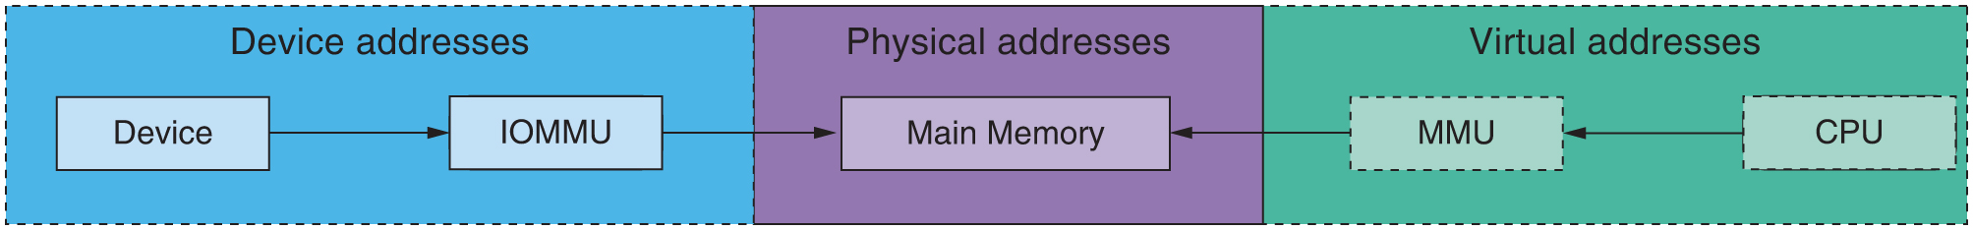
I/O Virtualization (2)
I O M M U is much like the normal M M U, but virtualizes I/O
Device pass through allows the device to be directly assigned to a V M
Device address not same as physical address
I O M M U translates device addresses to the actual physical addresses, using page tables
D M A from V M 1’s device cannot trample over V M 2’s memory
Notes:
Long Description:
Three sections are device addresses, physical addresses, and virtual addresses. The linear flow is from the blocks device and I O M M U in device addresses to main memory in physical addresses. The linear flow is from the blocks C P U and M M U in virtual addresses to main memory in physical addresses.

Slide 42
Containers and O S-level Virtualization

Slide 43
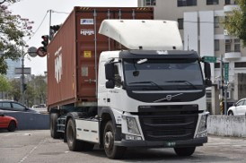
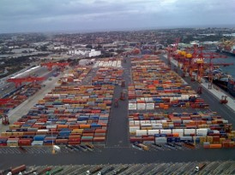
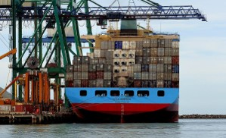
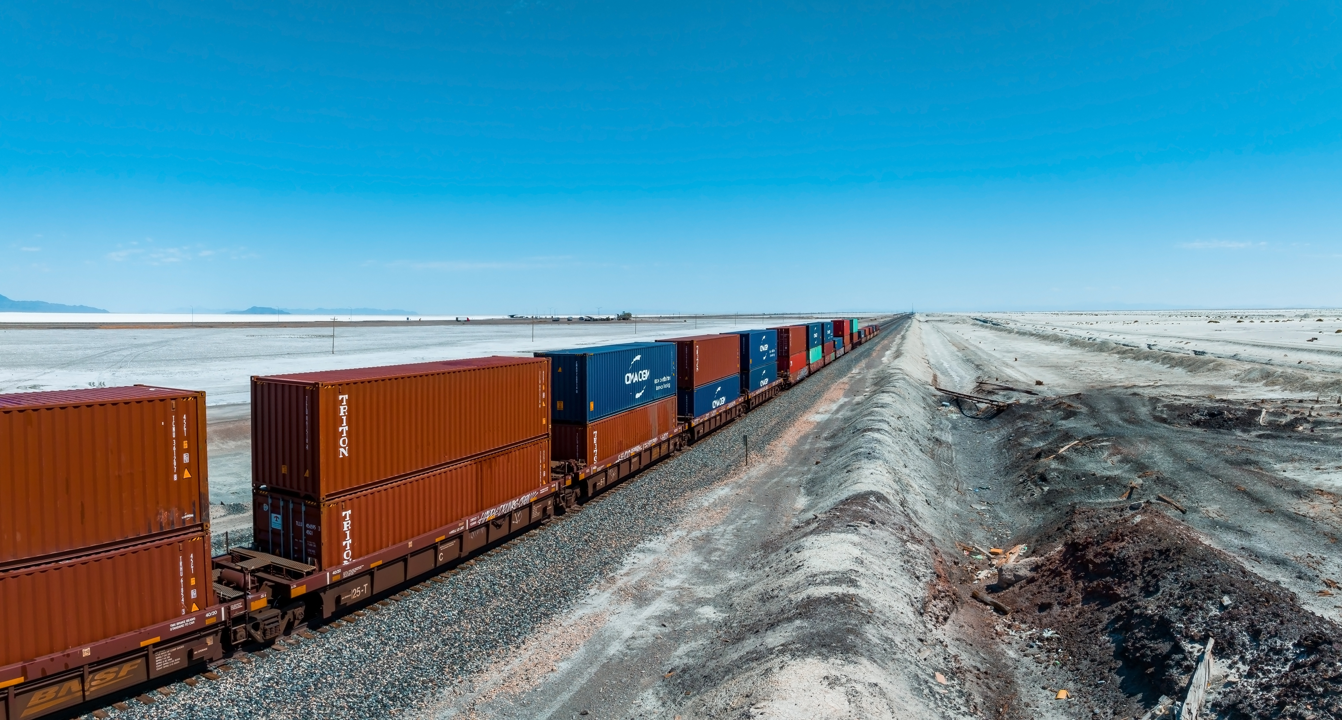
Containers are Great
Just pack your goods in a standard container, and they can be handled by:
Trucks on the road
Port
Ship
Port on other side of the world
Train on other side of the world
Soleg/123 R F
Travel mania/Shutterstock
Bernard Spragg
RAW-films/Shutterstock

Slide 44
Software Containers: Virtual Appliances
Same idea with software containers
Build/package your software into a container once
Now it runs on my machine, your machine, the cloud, etc.
We can do this with V M s and a hypervisor: virtual appliance
But that sounds overkill:
We don’t need a whole separate O S
We don’t need virtualized hardware
All we need is our own sandboxed “view” of the file system, users, processes, etc.

Slide 45
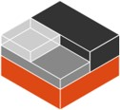


O S-level Virtualization (1)
So opt for O S-level (rather than V M M-based) virtualization:
Provide an isolated environment known as a container
O S primitives to sandbox file system, processes, users, resources, networking, etc. with private name spaces
Much more lightweight than V M s!
Platforms using these primitives:
Docker
L X C
Kubernetes
Amazon E C S
© 2013-2023 Docker, Inc. All rights reserved
Linux Containers logo
The Linux Foundation

Slide 46
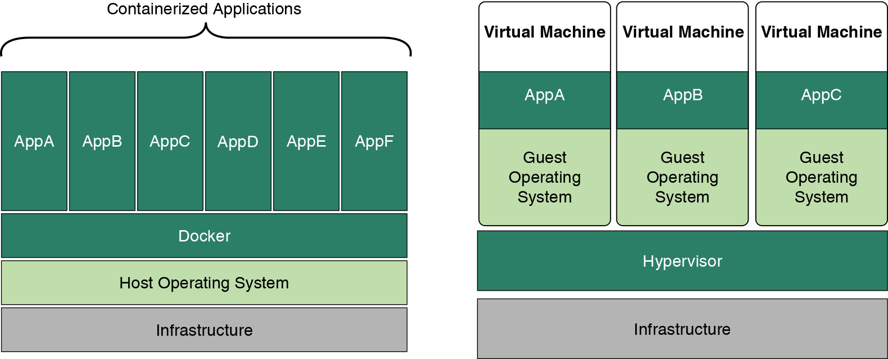
O S-level Virtualization (2)
Containers:
Do not provide machine abstraction, often run 1 application
Cannot run multiple operating systems
Can share base file systems (e.g., Overlay F S)
Rely on host O S for isolation primitives
Notes:
Long Description:
On the left, the top is divided into 6 columns namely A p p A to A p p F labeled containerized applications. The bottom has 3 rows titled docker, host operating system, and infrastructure. On the right, the top is divided into 3 columns labeled virtual machine, A p p A, B, C, guest operating system. The bottom has 2 rows titled hypervisor and infrastructure.

Slide 47
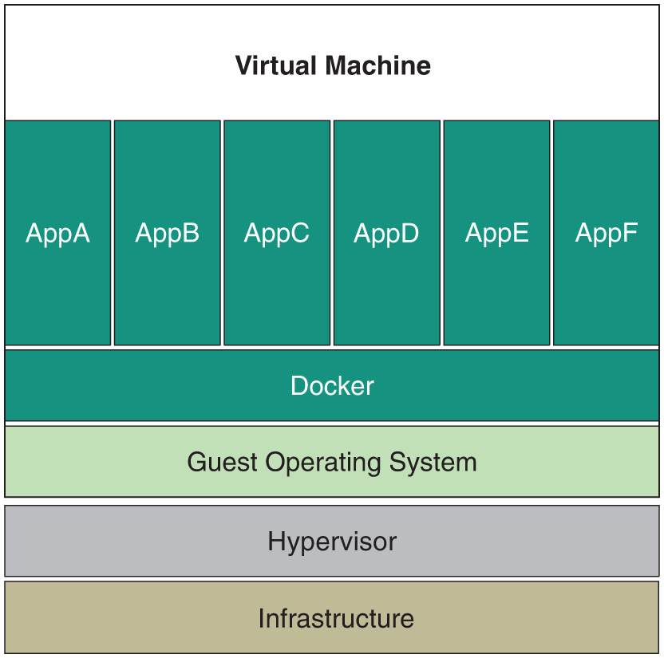
O S-level Virtualization (3)
What about the interface to the kernel (i.e., syscalls)? These are O S specific, so how do we run the same container on Linux, mac O S, Windows, etc?
Answer: (hypervisor-based) virtualization!
Modern cloud deployments often contain multiple nested layers of V M s and containers
Notes:
Long Description:
It comprises 2 parts. The top is divided into 6 columns namely A p p A to A p p F labeled virtual machine with 2 rows at the bottom titled decker and guest operating system. The bottom has 2 rows titled hypervisor and infrastructure.

Slide 48
Example: Linux Control Groups (cgroups)
A cgroup is a collection of processes bound to a set of limits or parameters defined via the (pseudo) cgroup file system
Provides namespace isolation, accounting, limiting, etc.
A subsystem (or resource controller) is a kernel component that modifies the behavior of the processes in a cgroup
Various subsystems have been implemented:
c p u set: bind processes to specific C P U s
memory: memory accounting and limiting
devices: device access control

Slide 49
Interesting Uses of Virtualization in O S

Slide 50
Qube O S
A reasonably secure desktop O S
Security by Compartmentalization
(Qubes is a user of a V M M, presently Xen)

Slide 51
Problems with Current O S s
Attacks from (exploited) apps (browsers, P D F readers, etc.)
Attacks from (malicious) apps (Spyware, Backdoors, etc.)
Attacks form (compromised) U S B devices
Attacks from networking stacks (D H C P client, WiFi driver/stacks)
Attacks via (malformed) F S/Volume Metadata (U S B sticks)
Lack of G U I isolation (sniffing content & clipboard, sniffing & spoofing keystrokes)

Slide 52
Monolithic Systems are Hard to Secure
WiFi & N I C & B T drivers & stacks
U S B drivers & stacks
File system modules & other volume processing code
All the various A P I s (e.g. debug, V F S, sockets A P I, etc)
Why should all these be part of Trusted Computing Base (T C B)?
Note: This is a similar observation to that made by microkernel enthusiasts

Slide 53
And Monolithism Goes Beyond the Kernel
G U I server (Xorg)
Various system services
Network Manager and other D-Bus endpoints
udev services (e.g. block device mounting)
C U P S, desktop indexing, etc.
Again, monolithic means: bloated, complex, difficult to understand, and manage

Slide 54
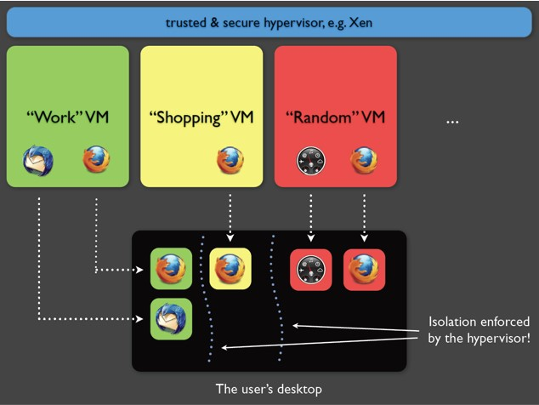
Qubes O S: Security by Compartmentalization
Notes:
Long Description:
It comprises 3 boxes on top left titled work V M, shopping V M, and random V M with 2, 1 and 2 servers, respectively. A box on the bottom titled user's desktop with 2, 1, 3 servers is connected to the top boxes via dotted arrows. They are segregated via dotted lines marked as isolation enforced by the hypervisor.

Slide 55
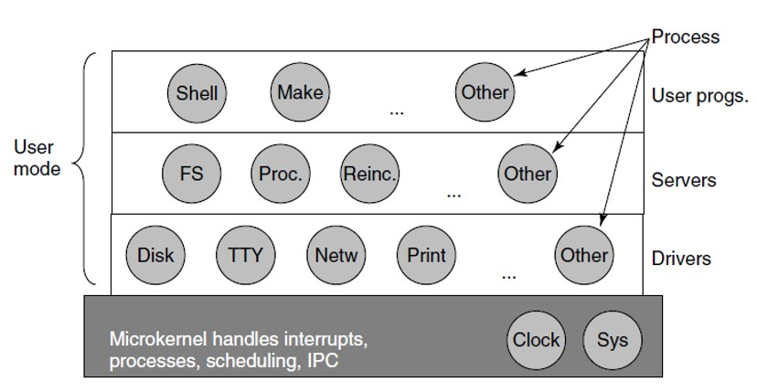
Again: Compare Microkernels
Notes:
Long Description:
It comprises a box divided into 4 horizontal boxes with 3, 4, 5, and 2 circles, respectively. The first 3 rows are marked as user mode. On the right, the first 3 rows are marked labeled as user progs dot, servers, and drivers. A process on the top right has 3 arrows that point at the circles on each row labeled the other. The last row labeled as microkernels handles interrupts processes, scheduling, I P C. The labels in the circles row wise are as follows: Row 1: Shell; Make; Other. Row 2: F S; Proc.; Reinc.; Other. Row 3: Disk; T T Y; Netw; Print; Other. Row 4 or the base row: Clock; Sys.

Slide 56
Virtualization for Compartmentalization
Use virtualization (V M s) to isolate domains from each
other
But why would V M s provide any better isolation than O S processes?
Is there anything wrong with x86 good old M M U/page/ring separation?
“Solving” problems by adding another layer of abstraction?

Slide 57
Virtualization
Allows us to REDUCE the interfaces (V M-V M & V M-T C B)
and preserve compatibility with LEGACY apps & drivers at the same time

Slide 58
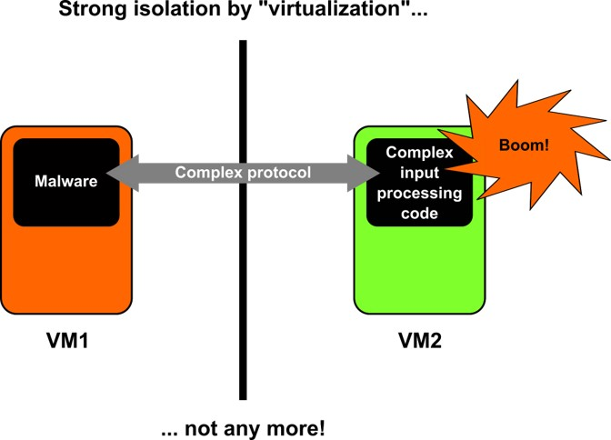
But It is Not Enough
Notes:
Long Description:
It comprises 2 boxes on either sides separated by a vertical line. The boxes are titled V M 1 and 2 and contain malware and complex input processing code labeled inside. The boxes are connected by a doubled headed arrow titled complex protocol. A speech bubble on the right box reads boom with an exclamation mark.

Slide 59
Lesson
Don’t get too excited about “hardware virtualization” isolation
Virtualization: nothing magic, offers little more than traditional M M U isolation
Except for I O M M U, but that’s for devices
Use new V T features to isolate as best as possible
Be careful about inter-V M interfaces and code that handles them!

Slide 60
App V M
A workspace where multiple apps can run
Read-only
If an App V M gets compromised by a virus (say your web browser), simply restart it
This is where you spend most of your time

Slide 61
I O M M U
Allows for truly de-privileged driver domains
We can have Net V M, U S B V M, etc.
By the way, microkernels without I O M M U: security issues!

Slide 62
NetVM
Sandboxes things like WIFI driver, network stack, etc.
Unprivileged V M (no access to any hardware)
Only has access to the network card and network drivers (through Intel V t-d)
App V M s have no access to the networking hardware
App V M s pipe traffic through Net V M to get access to internet
If bug in network driver or network hardware, App V M s won’t be compromised
But the user may not have internet access if the network driver gets hacked

Slide 63
U S B V M
Similarly, sandbox the U S B stack
Hackers like to spread viruses through U S B exploits
Conficker
Stuxnet (Took down Iranian nuclear reactors!)
Rule of thumb: never insert untrusted U S B sticks

Slide 64
But if you Must
Isolate U S B access in a separate V M
U S B V M only part that has access to the U S B through Intel V T-d
If the U S B drivers get exploited, only the U S B V M is affected
Rest of the system stays safe

Slide 65
Proxy V M / Tor V M
A Proxy V M acts as a tunnel between App V M and Net V M
Allows for interesting stuff like:
Force network over Tor or V P N
Add Firewall rules

Slide 66
Tor V M (1)
Because Tor V M only exposes one interface to App V M
Traffic can only go through Tor V M to get to Net V M
So we are 100% sure no out-of-band information leaks
If the App V M gets compromised (through a browser exploit for example), the Tor Daemon is in another V M
The hacked App V M can’t damage it
User stays anonymous

Slide 67
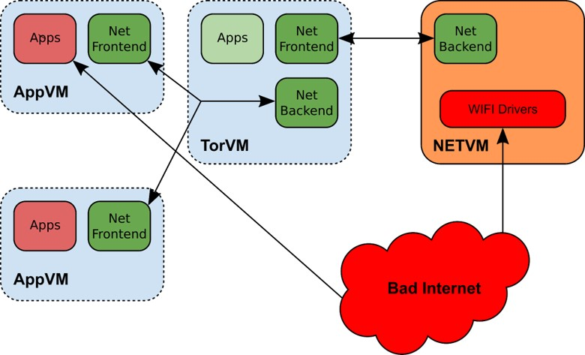
Tor V M (2)
Notes:
Long Description:
It comprises 3 dotted and a straight lined interconnected boxes on the left and right titled A p p V M, T o r V M and A p p V M with 2, 3, and 2 boxes titled apps, net frontend, apps, net frontend, net backend, and apps, net frontend and N E T V M with net backend and wifi driver boxes. Bad internet on the bottom right is connected to A p p V M and N E T V M.

Slide 68

Copyright
This work is protected by United States copyright laws and is provided solely for the use of instructors in teaching their courses and assessing student learning. Dissemination or sale of any part of this work (including on the World Wide Web) will destroy the integrity of the work and is not permitted. The work and materials from it should never be made available to students except by instructors using the accompanying text in their classes. All recipients of this work are expected to abide by these restrictions and to honor the intended pedagogical purposes and the needs of other instructors who rely on these materials.

